Slide 1
What If Delivery Is the Missing Link In Cancer Immunotherapy?
Insights from DNA Cancer Vaccine Trials Using Needle-Free Injection Delivery
Cancer & Immunotherapy Vaccines
World Vaccine Congress, Washington DC
April 23, 2025
Doc. #60-10373-031AC

Slide 2



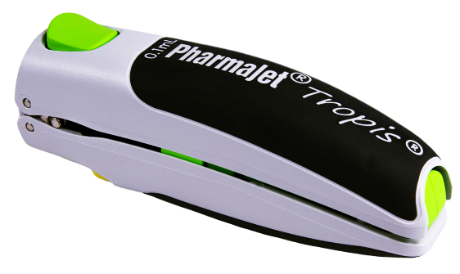
PharmaJet at a Glance
VISION:
To lead a transformation on how medicines harness the full power of the immune system
MISSION:
To improve performance and outcomes of medicines with breakthrough delivery technology that navigates the immune system
Private company headquartered in Golden, Colorado, USA
Team of professionals with global experience across the spectrum of drug-device development, commercialization, and medical affairs
3
Products approved for use with PharmaJet technology
1st
And only needle-free delivery system to achieve World Health Organization standards for Pre-qualification
12M+
Active clinical-stage partnerships in infectious disease and oncology indications
Vaccinations delivered for polio in pediatric populations
13

Slide 3

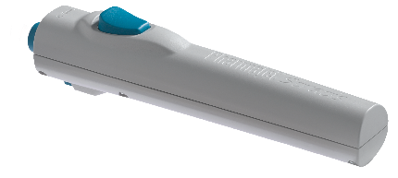

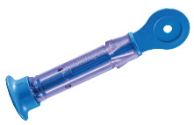
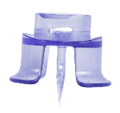

PharmaJet Needle-Free Delivery System Components
Tropis ® ID
Stratis ® IM/SC
Delivery Injector Types
Spring loading achieved with injector handles
Spring loading achieved by use of Reset Station*
Reusable up to 20,000 injections
Needle-free Syringes
0.1ml fixed volume
Filled at bedside
Single-use, disposable
0.5ml fixed volume
Adapters
Fits up to 20mm vials
Fits up to 20mm vials
Attaches syringe to vial
Single-use per vial, disposable
* Reset station not shown

Slide 4
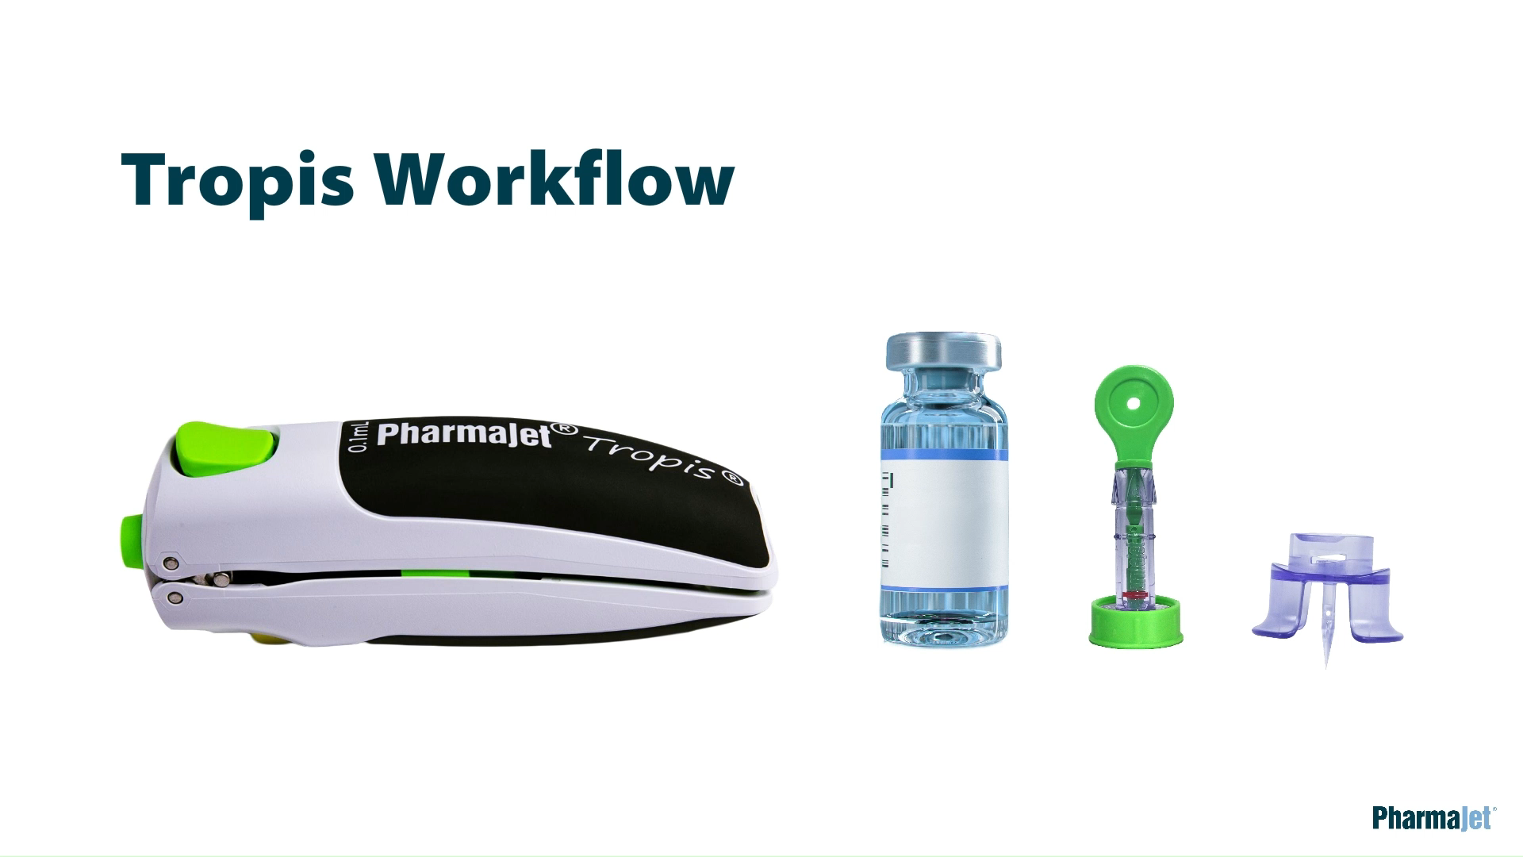

Slide 5
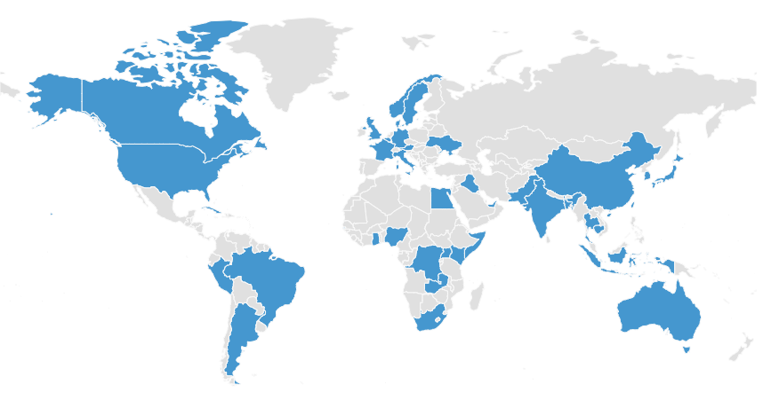



Market Access through Global Partners and Regulatory Clearances
Global Development and Commercial Partnerships
^{Regulatory Clearances}
PharmaJet’s Needle-free Injection Systems are validated commercial devices, having several regulatory clearances across the globe.
Tropis
Registrations:
US FDA Master File
European Union
WHO/PQS
Stratis
Registrations:
US FDA 510(k)
European Union
WHO/PQS
^{Headquarters:}
^{Golden, CO, USA}
Contact PharmaJet for details on Regulatory Clearance in a specific country.
PharmaJet’s needle-free injection devices are the first and only to achieve World Health Organization standards for Pre-qualification.

Slide 6
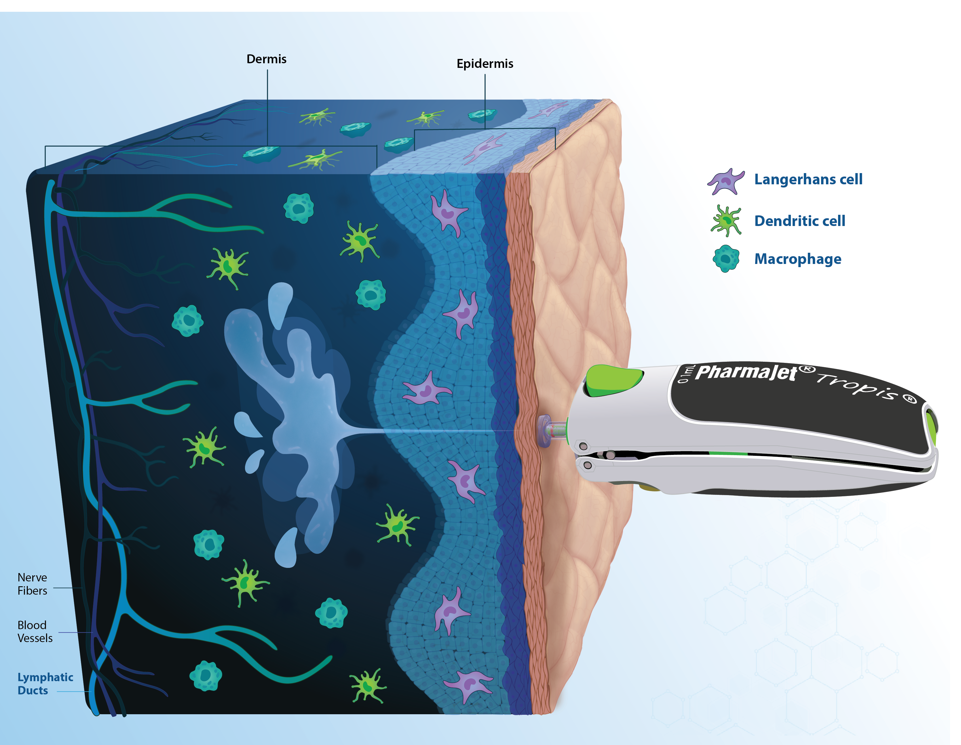
The Benefits of Intradermal (ID) Delivery
Induce long-lived antibody responses
  Dermal Dendritic Cells and Langerhans cells are pivotal at promoting follicular helper CD4+ T cell differentiation, germinal centers formation and B cell maturation ¹
Promote CD8+ T cell responses
  Skin resident APCs have the ability to migrate to lymph nodes and bone marrow, to present processed antigens with MHC Class I and to initiate CD8+ T cell responses ^{2,}
Benefits compared to IM delivery ⁴
  Longer duration of the antibody response
  Mucosal Immunity
  Cross-reactive antibody and T cell responses
Rich in diversity of Antigen Presenting Cells (APCs) ³
  Langerhans cells, dendritic cells, macrophages, monocytes and neutrophils
Lymph ducts allowing migration of antigens and APCs to lymph nodes ³
1. West, H. C., & Bennett, C. L. (2018). Redefining the Role of Langerhans Cells As Immune Regulators within the Skin. Front. Immunol. 8(1941),1-5. 2. Kashem, S. W., Haniffa, M., & Kaplan, D. H. (2017). Antigen-presenting cells in the skin. Annual Review of Immunology, 35, 469–499.
3. Lind, A., et al. (2012). Intradermal vaccination of HIV-infected patients with short HIV Gag p24-like peptides induces CD4⁺ and CD8⁺ T cell responses lasting more than seven years. Scandinavian Journal of Infectious Diseases, 44(8), 566–572.
4. Hernandez-Franco, et al. (2023). Intradermal Vaccination against Influenza with a STING-Targeted Nanoparticle Combination Adjuvant Induces Superior Cross-Protective Humoral Immunity in Swine Compared with Intranasal and Intramuscular Immunization. Vaccines, 11, 1-17.
Notes:
RREF: 1. West, H. C., & Bennett, C. L. (2018). Redefining the Role of Langerhans Cells As Immune Regulators within the Skin. Front. Immunol. 8(1941),1-5.
2. Lind, A., et al. (2012). Intradermal vaccination of HIV-infected patients with short HIV Gag p24-like peptides induces CD4⁺ and CD8⁺ T cell responses lasting more than seven years. Scandinavian Journal of Infectious Diseases, 44(8), 566–572.
3. Kashem, S. W., Haniffa, M., & Kaplan, D. H. (2017). Antigen-presenting cells in the skin. Annual Review of Immunology, 35, 469–499.
4. Hernandez-Franco, et al. (2023). Intradermal Vaccination against Influenza with a STING-Targeted Nanoparticle Combination Adjuvant Induces Superior Cross-Protective Humoral Immunity in Swine Compared with Intranasal and Intramuscular Immunization. Vaccines, 11, 1-17.

Slide 7
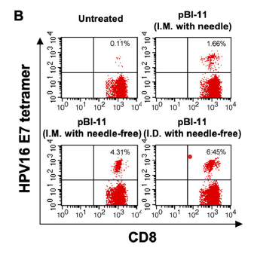
Tropis ID Delivery of a Therapeutic HPV Vaccine (pBI-11) Enhanced CD8⁺ T Cell Response in Preclinical Model
Increased CD8+ T Cells
Study Summary:
Mice were challenged with TC-1 tumor cells (Day 0) and vaccinated on Days 3, 6, and 10 via different delivery methods
PBMCs collected on Day 17 to assess E7-specific CD8⁺ T cell responses
Measured Outcome: % of HPV16 E7⁺ CD8⁺ T cells
Key Findings:
Tropis intradermal delivery showed the highest CD8⁺ T cell response
Needle-free methods (ID and IM) outperformed traditional needle injection
Needle-free ID delivery provided the most potent immunogenicity
Needle-free ID delivery with Tropis resulted in the strongest CD8⁺ T cell response (6.45%)
Peng, S., et al. (2023). Immune responses, therapeutic anti-tumor effects, and tolerability upon therapeutic HPV16/18 E6/E7 DNA vaccination via needle-free biojector.mBio,14(5), 1-19.
Notes:
REF: Peng, S., et al. (2023). Immune responses, therapeutic anti-tumor effects, and tolerability upon therapeutic HPV16/18 E6/E7 DNA vaccination via needle-free biojector.mBio,14(5), 1-19.

Slide 8
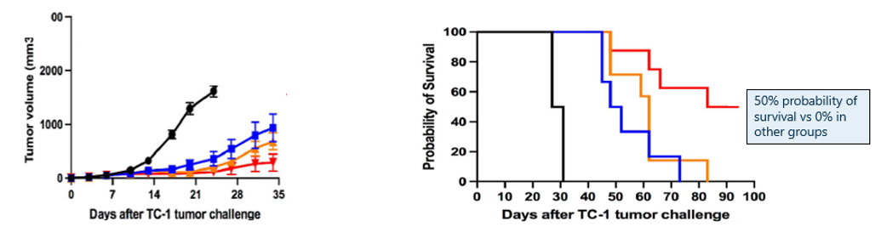

Tropis ID Delivery of a Therapeutic HPV Vaccine (pBI-11) Slowed Tumor Growth and Improves Survival
Preclinical study in mice challenged with TC-1 tumor cells and treated with pBI-11 DNA vaccine
ID needle-free delivery significantly slowed tumor growth compared to untreated and intramuscular needle groups
ID needle-free delivery significantly improved survival compared to untreated and intramuscular needle groups
Peng, S., et al. (2023). Immune responses, therapeutic anti-tumor effects, and tolerability upon therapeutic HPV16/18 E6/E7 DNA vaccination via needle-free biojector.mBio,14(5), 1-19.
Notes:
REF: Peng, S., et al. (2023). Immune responses, therapeutic anti-tumor effects, and tolerability upon therapeutic HPV16/18 E6/E7 DNA vaccination via needle-free biojector.mBio,14(5), 1-19.

Slide 9

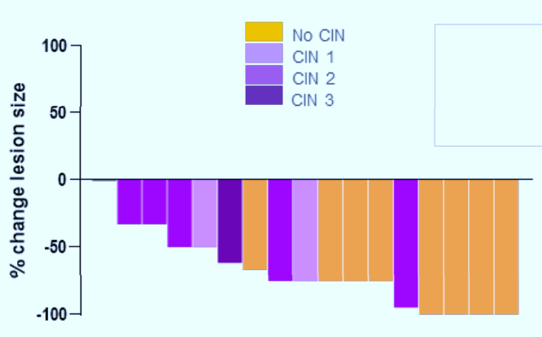
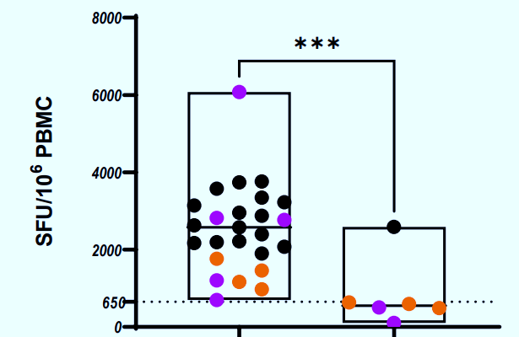


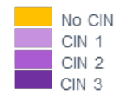


Stratis IM delivery of HPV DNA vaccine (VB10.16) resulted in a 94% reduction in lesion size in CIN2/3 patients
Change in Cervical Lesion Size
from Baseline (N=17)
HPV16-Specific T Cell Responses by
Lesion Size Outcome
Adapted from Hillemanns, et al. (2022)
CIN = Cervical Intraepithelial Neoplasia and final pathology (CIN grade) after treatment
Adapted from Hillemanns, et al. (2022)
16/17 patients showed reduction in lesion size (color-coded by residual CIN grade)
% Change in Lesion Size from Baseline
HPV-specific T cells (SFU/10⁶ PBMC)
% Change Lesion Size
Individual Patients
Lesion Size Regression
No Lesion Size Regression
94% (16/17) of patients with
any measurable reduction in cervical lesion size regardless of CIN grade post treatment
Significantly higher HPV-specific T cell responses observed in the treatment group
9
Hillemanns, P., et al. (2022). A therapeutic antigen-presenting cell-targeting DNA vaccine VB10.16 in HPV16-positive high-grade cervical intraepithelial neoplasia: Results from a Phase I/IIa trial. Clinical Cancer Research, 28(22), 4885-4892.
Notes:
REF: Hillemanns, P. , et al. (2022). A therapeutic antigen-presenting cell-targeting DNA vaccine VB10.16 in HPV16-positive high-grade cervical intraepithelial neoplasia: Results from a Phase I/IIa trial.
Clinical Cancer Research, 28(22), 4885-4892.

Slide 10
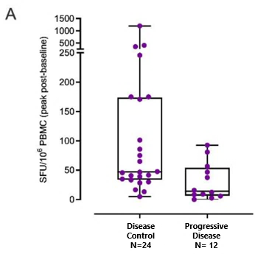
Stratis IM Delivery of HPV DNA Vaccine (VB10.16) Induced T Cell Responses and Disease Control In Advanced Cervical Cancer
HPV16-specific T cell responses
in relation to clinical outcome
(N=36)
Summary of Disease Control Rates
P = 0.011
Population/subgroup | N | DCR (95% CI)
All | 47* | 59.6 (44.3 to 73.6)
PD-L1+ | 24 | 75.0 (53.3 to 90.2)
PD-L1− | 16 | 50.0 (24.7 to 75.3)
* PD-L1 expression status is missing for seven patients
Patients that were PD-L1+ (N=24) experienced the highest clinical benefit, demonstrating a 75% disease control rate (DCR)
Patients with disease control had significantly higher HPV-specific T cell responses
(p = 0.011)
Hillemanns P. , Zikan M., Forget F. , et al. (2025). Safety and efficacy of the therapeutic DNA-based vaccine VB10.16 in combination with atezolizumab in persistent, recurrent or metastatic HPV16-positive cervical cancer: a multicenter, single-arm phase 2a study Journal for Immuno Therapy of Cancer;13:e010827. 1-10.
Notes:
REF: Hillemanns P. , Zikan M., Forget F. , et al. (2025). Safety and efficacy of the therapeutic DNA-based vaccine VB10.16 in combination with atezolizumab in persistent, recurrent or metastatic HPV16-positive cervical cancer: a multicenter, single-arm phase 2a study Journal for Immuno Therapy of Cancer;13:e010827. 1-10.

Slide 11
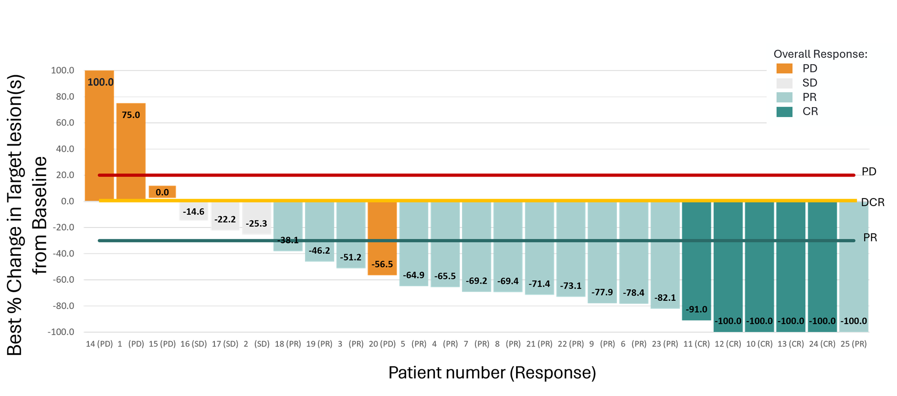
SCIB1 Delivered via Stratis IM Demonstrated Strong T Cell Responses that Correlated with and Tumor Reduction in Advanced Melanoma
Significant increase in antigen-specific T cell responses from baseline following SCIB1 vaccination (p < 0.0001)
Phase 2 Vaccine Trial:
Scancell’s ImmunoBody® Cancer Vaccine (SCIB1) N= 25
25 Patients at 25 weeks demonstrating 72% Overall Response Rate at 6 months
Normalized spot count per million cultured PBMCs
Immune activation observed across multiple epitopes, demonstrating broad immunogenicity of SCIB1. 16 / 23 (70%) demonstrated a T-cell response that strongly correlated with best overall response.
SCOPE trial continues with a cohort assessing next generation iSCIB1+ via ID delivery with Tropis
Shaw, H., et al. (February 2025). A DNA plasmid melanoma cancer vaccine, SCIB1, combined with nivolumab + ipilimumab in patients with advanced unresectable melanoma: Efficacy and safety results from the open-label Phase 2 SCOPE Trial. [Poster presentation]. American Association for Cancer Research (Immuno-Oncology).
Notes:
REF: Shaw, H., et al. (February 2025). A DNA plasmid melanoma cancer vaccine, SCIB1, combined with nivolumab + ipilimumab in patients with advanced unresectable melanoma: Efficacy and safety results from the open-label Phase 2 SCOPE Trial. [Poster presentation]. American Association for Cancer Research (Immuno-Oncology).

Slide 12
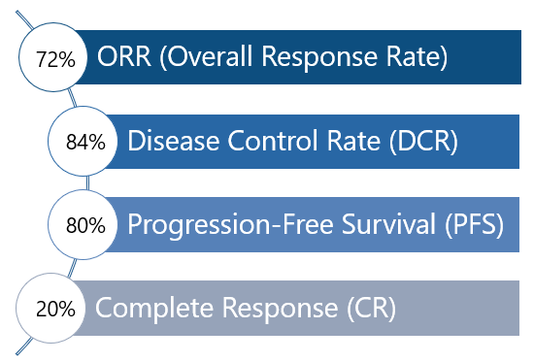
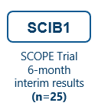
SCIB1 Trial Shows Promising Interim Responses; iSCIB1+ Expands with Tropis ID Delivery Cohort
SCOPE Trial Program
H2 – 2025
Vaccine Background
Clinical data → Next-gen study design → Tropis expansion
SCIB1
First-generation non-personalized Cancer DNA vaccine (ImmunoBody® platform); IM delivery
iSCIB1+
Next-generation modified version of SCIB1 (AvidiMab® platform); enhanced formulation; broader patient population use.
iSCIB1+
→
Tropis (ID) Cohort
(N=43)
Next-generation vaccine with ID delivery cohort
25-week ORR data expected mid-to-late 2025
PharmaJet enabled IM delivery in SCIB1 and now supports ID delivery via Tropis in iSCIB1+
Scancell (2025, January 30). Interim Results for the six months ended 31 October 2024 [Press release].
Notes:
REF: Scancell. (2025, January 30). Interim Results for the six months ended 31 October 2024 [Press release].
The double checkpoint inhibitors alone without the Scancell platform yields an ORR ~ 48%
Adding Scancell platform increases the overall response rate to 72%

Slide 13
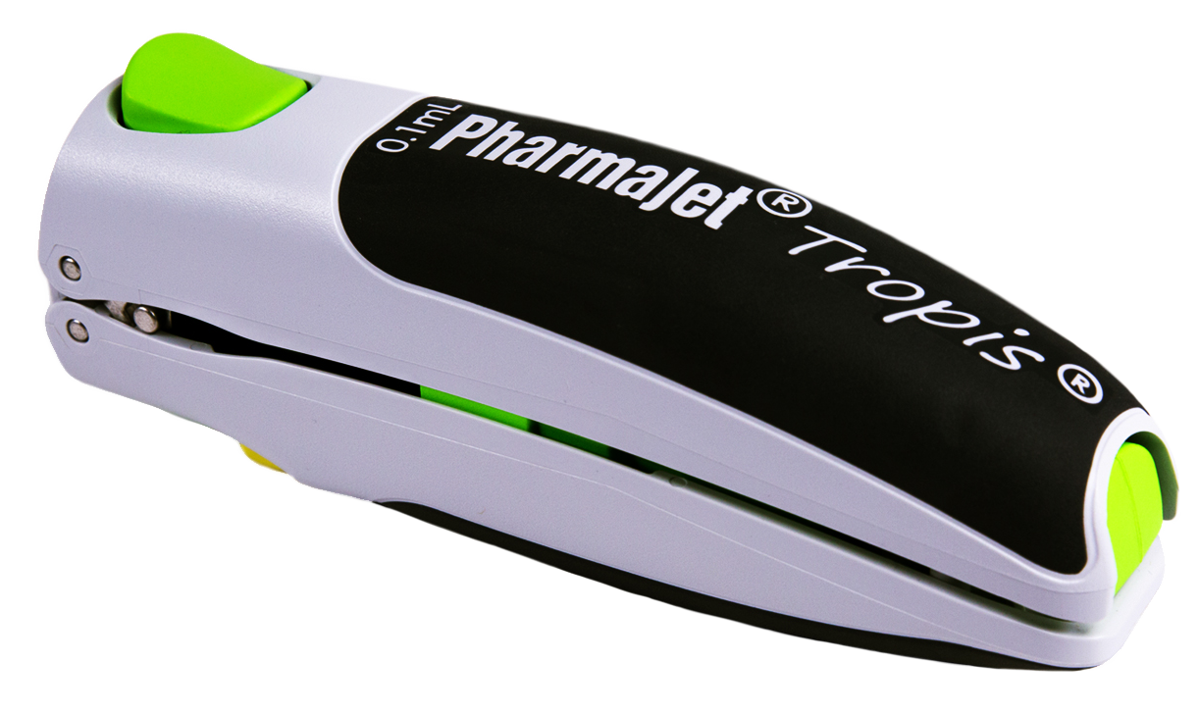
Conclusions: Partners Are Harnessing Needle-Free Delivery to Advance Cancer Vaccine Pipelines
Needle-Free Delivery Induces Immune Responses Across Studies
CD4⁺ and CD8⁺ T cell responses observed in both preclinical and clinical trials
ID delivery using Tropis (preclinical) resulted in stronger immune responses and improved survival compared to needle injection
Ongoing cancer vaccine trials demonstrated broad immune activation and tumor reduction using needle-free delivery
Clinical Benefit Demonstrated in Cancer Vaccine Trials
HPV DNA vaccines: Demonstrated lesion size reduction, disease control, and increased survival probability in both monotherapy and in combination with checkpoint inhibitors
SCIB1 melanoma vaccine: Higher objective response rates observed when combined with checkpoint inhibitors and delivered via needle-free injection
ID delivery with Tropis In partnership with Scancell, an intradermal cohort with iSCIB1+
has been added to the SCOPE trial
Tropis: The Only Commercially Scaled ID Needle-Free Platform
12+ million vaccinations administered
CE marked and WHO prequalified
Notes:
Immune activation observed with needle-free ID delivery across studies
CD4⁺ and CD8⁺ T-cell responses reported in preclinical and clinical models
Increased immunogenicity observed across multiple vaccine platforms
Ongoing studies are comparing ID and IM delivery routes

Slide 14
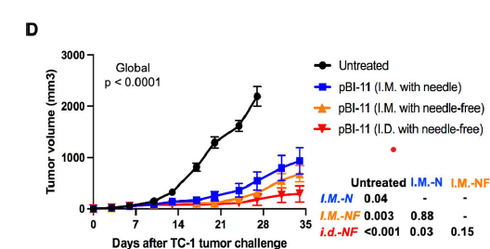
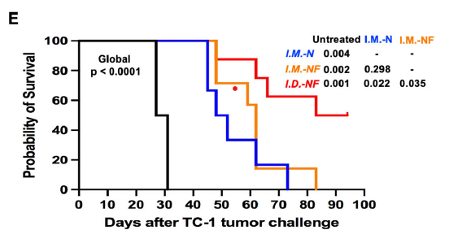
Intradermal (ID) Delivery of a Therapeutic HPV Vaccine Using Tropis® Slows Tumor Growth and Improves Survival
Preclinical study in mice challenged with TC-1 tumor cells and treated with the HPV DNA vaccine pBI-11
50% probability of survival vs 0% in other groups
ID needle-free vaccination significantly slowed tumor growth compared to untreated and I.M.-needle groups.
ID needle-free vaccination significantly improved survival compared to all other groups.
Peng, et al (2023). Immune responses, therapeutic anti-tumor effects, and tolerability upon therapeutic HPV16/18 E6/E7 DNA vaccination via needle-free biojector. PMID: 37791765
Notes:
Messaging: Use this as an example of ID delivery providing benefits. Other partners taking this and adding Tropis to their studies move onto Scancell and other studies
Survival was significantly longer in the ID needle-free group compared to untreated, IM needle, and IM needle-free groups (p < 0.05 for all comparisons)
1. Why was ID – (with needle ) not done?

